Slide 1


Science
Fabulous Forces
Year One
Science | Year 5 | Forces | Fabulous Forces | Lesson 1

Slide 3
Aim
To identify forces acting on objects.
Success Criteria
I can identify forces as pushes and pulls.
I can identify and explain the different forces acting on objects.

Slide 4







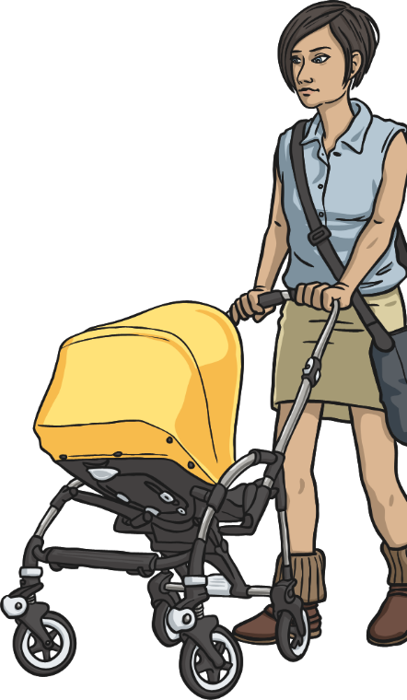
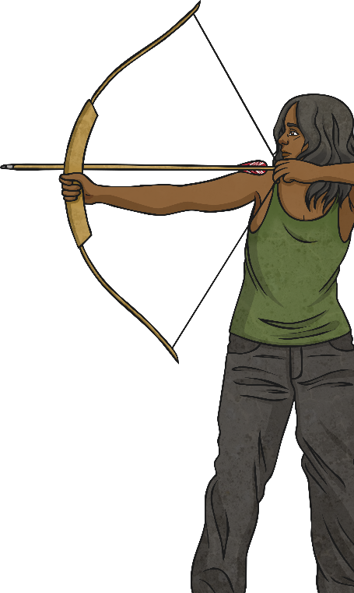
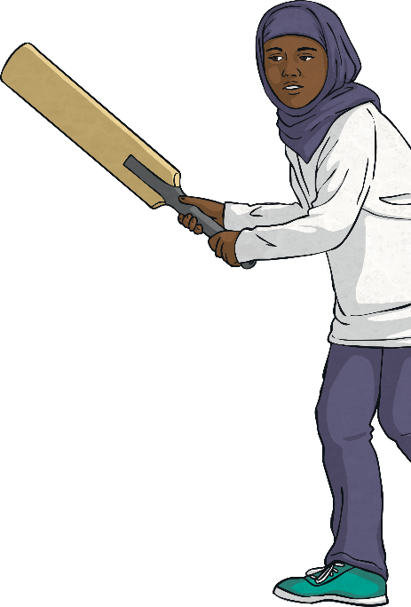
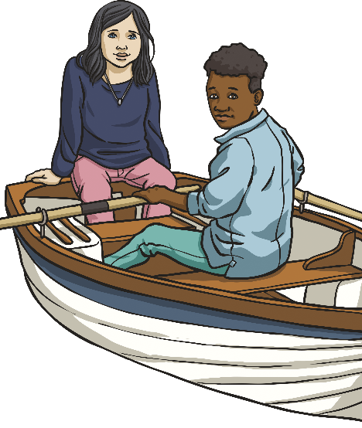

What Are Forces?
Forces are often referred to as pushes and pulls.
Look at the pictures below and talk to your partner about whether each picture shows an example of a pushing or pulling force.

Slide 5

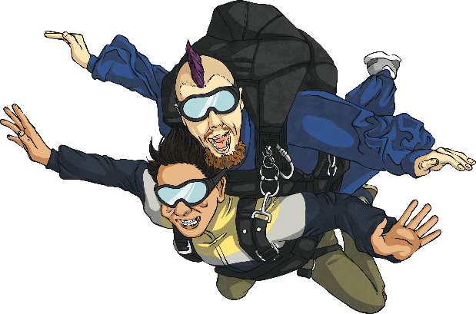
What Are Forces?
Forces affect the movement or shape of an object. They can make an object start to move, stop moving, move faster or move more slowly. They could also make an object change its shape or cause a moving object to change direction.
What is the name of the force pulling the skydivers down?

Slide 6
What Are Forces?
Gravity is a pulling force exerted by the Earth. The gravitational force from the Earth pulls in a direction towards the centre of the Earth.
Gravity is pulling the skydivers towards the Earth.
gravity

Slide 7
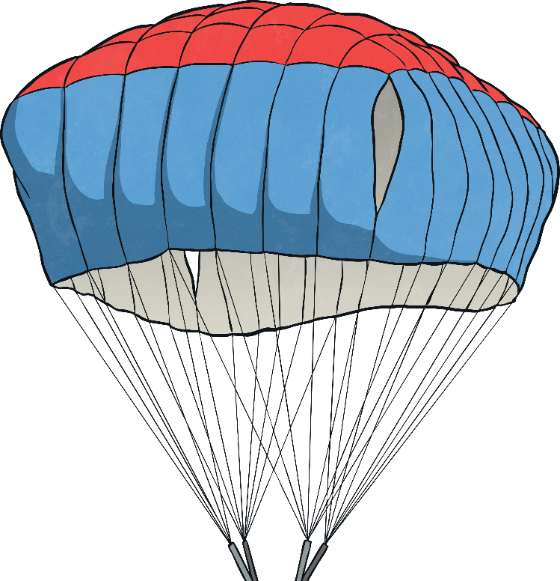

What Are Forces?
In this image, you can see that a force is slowing the skydivers down.
This force is pushing in the opposite direction to gravity.
Talk to your partner about what is happening in this picture.

Slide 8


What Are Forces?
Air resistance is the name of the force that is pushing up against the parachute.
Gravity is pulling the skydivers towards the ground. However, they are slowed down because a force (air resistance) pushes against the inside of the parachute and they descend more slowly.
Gravity and air resistance are opposing forces in this situation.
air resistance
gravity

Slide 9
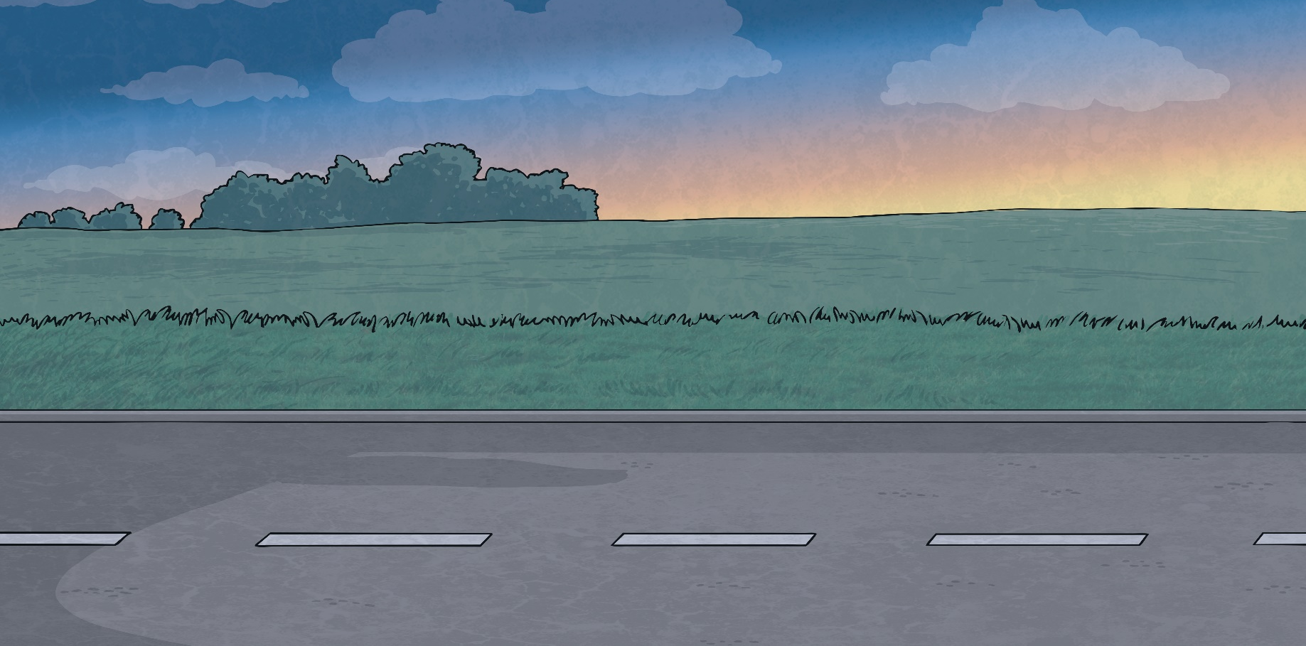
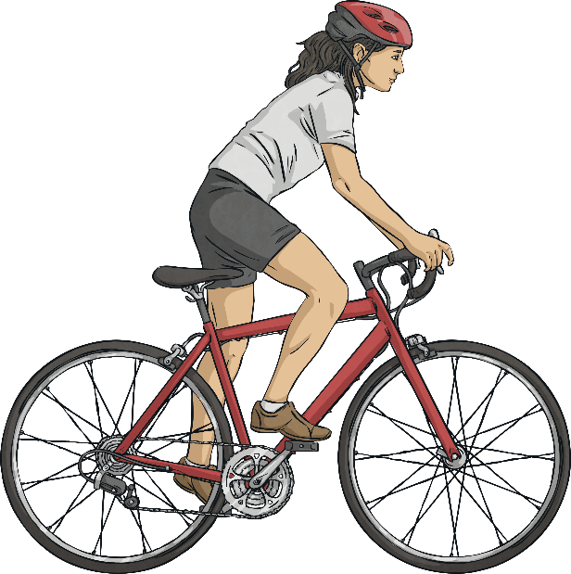
What Are Forces?
As well as gravity and air resistance, there are other forces that can act on objects.
What forces do you think might be represented by the arrows in this image?
cyclist’s driving force
friction

Slide 10
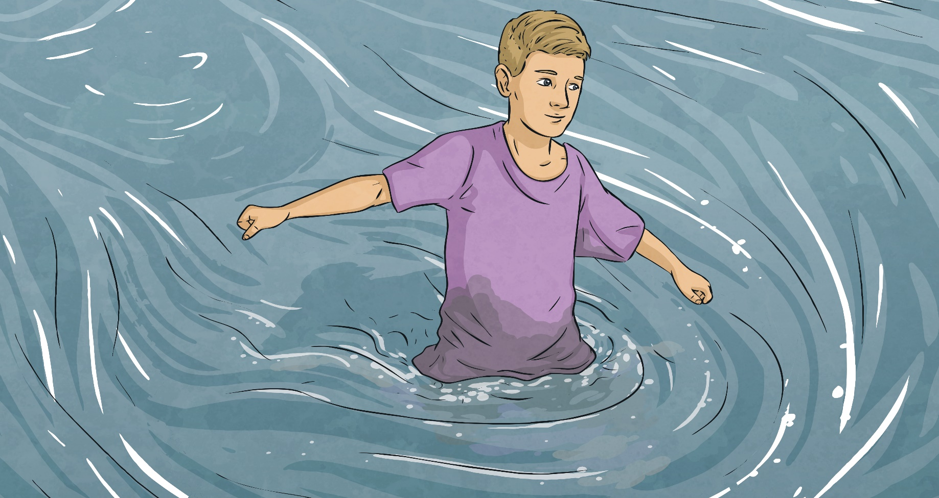
What Are Forces?
What forces do you think might be represented by the arrows in this image?
The man is wading through a flowing river.
man’s pushing force
water resistance

Slide 11

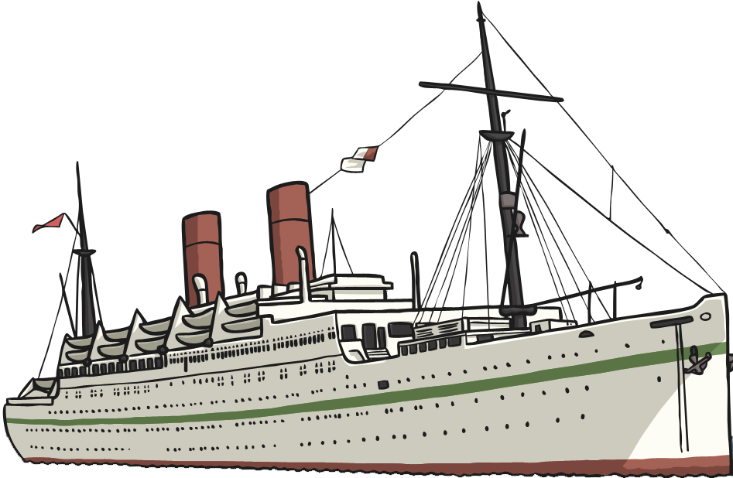
What Are Forces?
What forces do you think might be represented by the arrows in this image?
gravity
In this example, the boat doesn’t sink because there is a buoyant force (upthrust) created by the volume of water. It is the balance of the gravity and the buoyancy that keeps the boat floating.
buoyancy

Slide 12


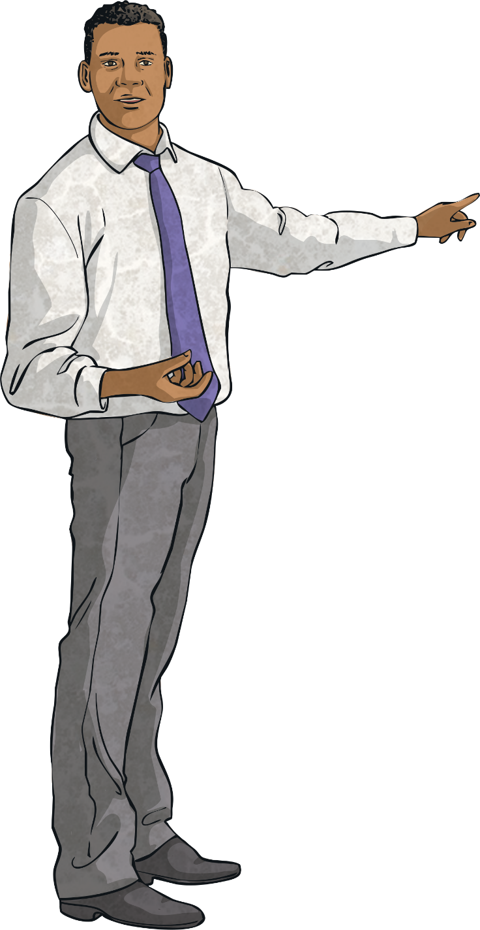
Identifying Forces
Your teacher will choose a Force Card and say the name of a force.
If you have this force missing on one of your pictures, you can write the name of the force next to the correct arrow. You may be able to choose from more than one picture when writing the missing force.
When you have completed three pictures in a row, you should shout ‘Bingo!’.
You are going to play a game to identify different types of forces!
Each person has an Identifying Forces Bingo Board with pictures of different actions on.
The actions have arrows to show the forces acting on the object pictured but some names of forces are missing.

Slide 13
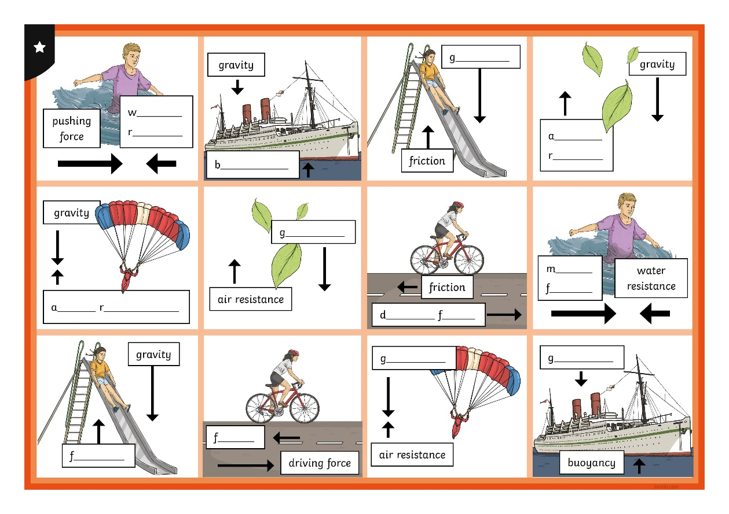
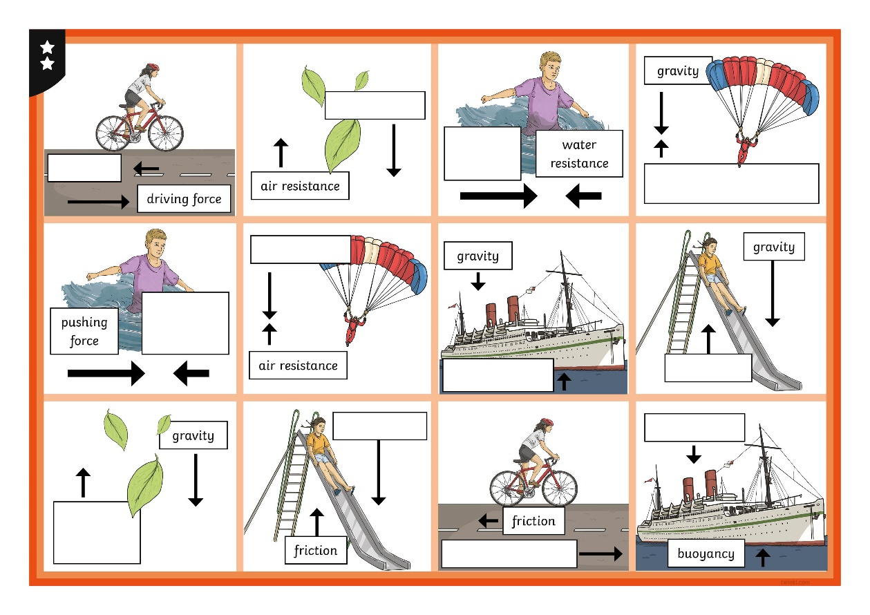
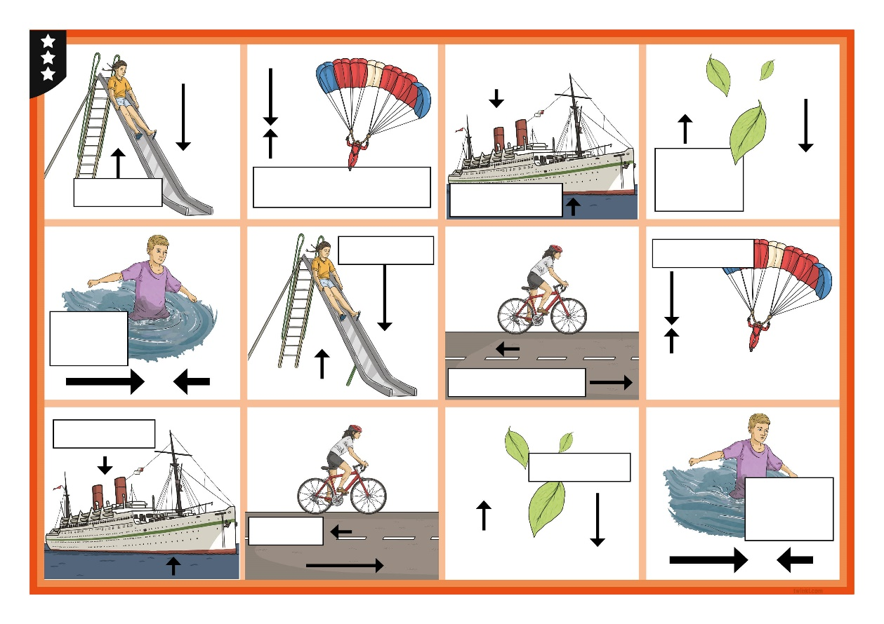
Identifying Forces Game

Slide 14
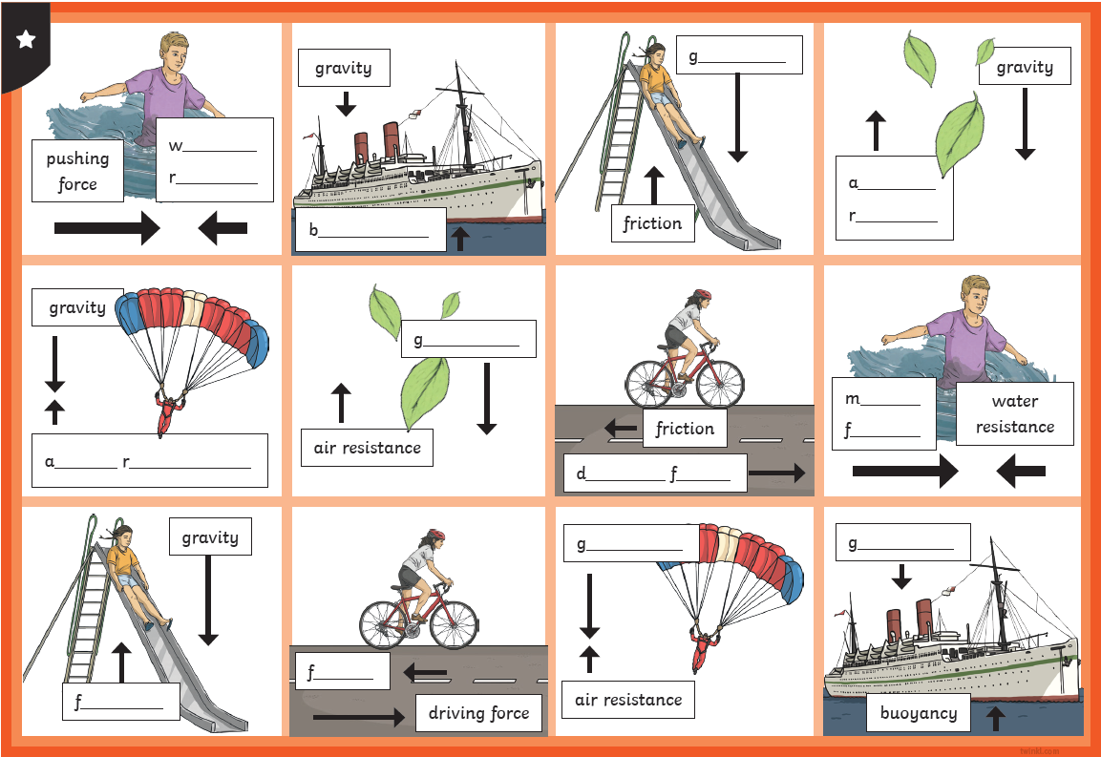
Level 1 Your task is to name all the forces in these pictures.
When you have done this, click for the next slide to check your answers and learn any you may not have known.

Slide 15
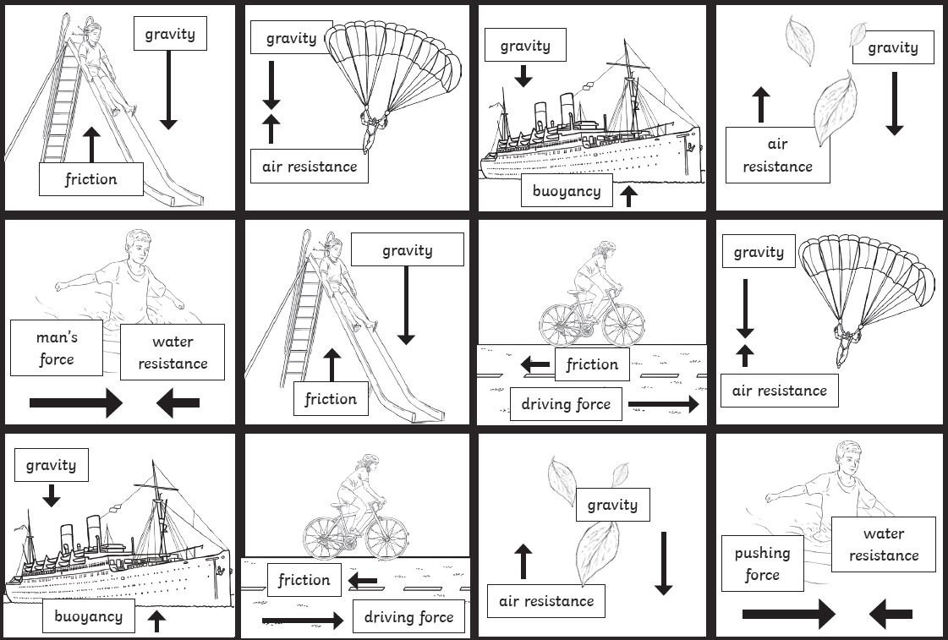

Slide 16
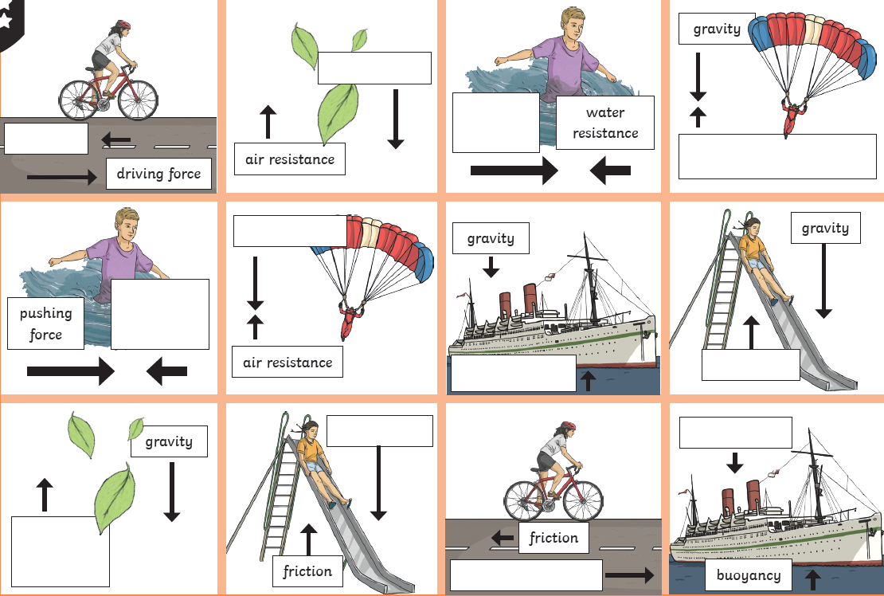
Level 2! Again, your task is to name all the forces in the pictures. This time, there are not so many clues! Can you do it? No clicking back!!!!
When you have done this, click to check answers and learn any not known.

Slide 18
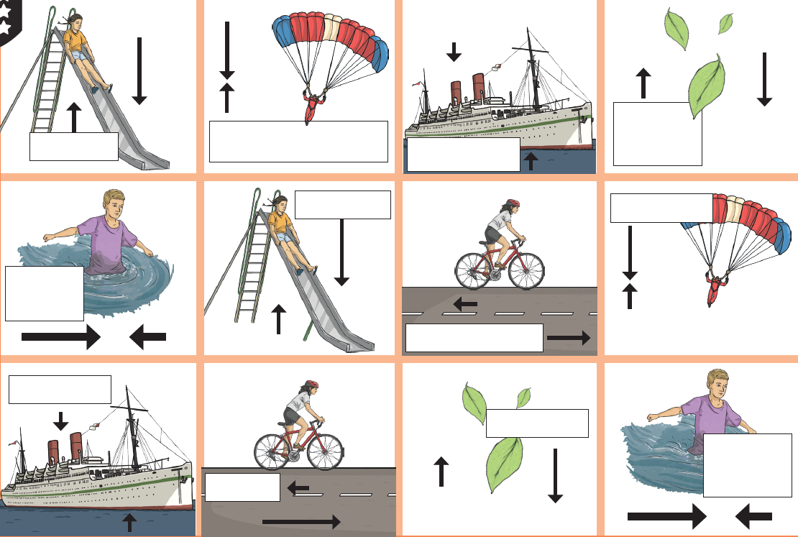
Level 3 - Ultimate challenge: Name all the forces in the pictures – no clues!
When you have done this, click for the next slide to check your answers and learn any you may not have known.

Slide 19
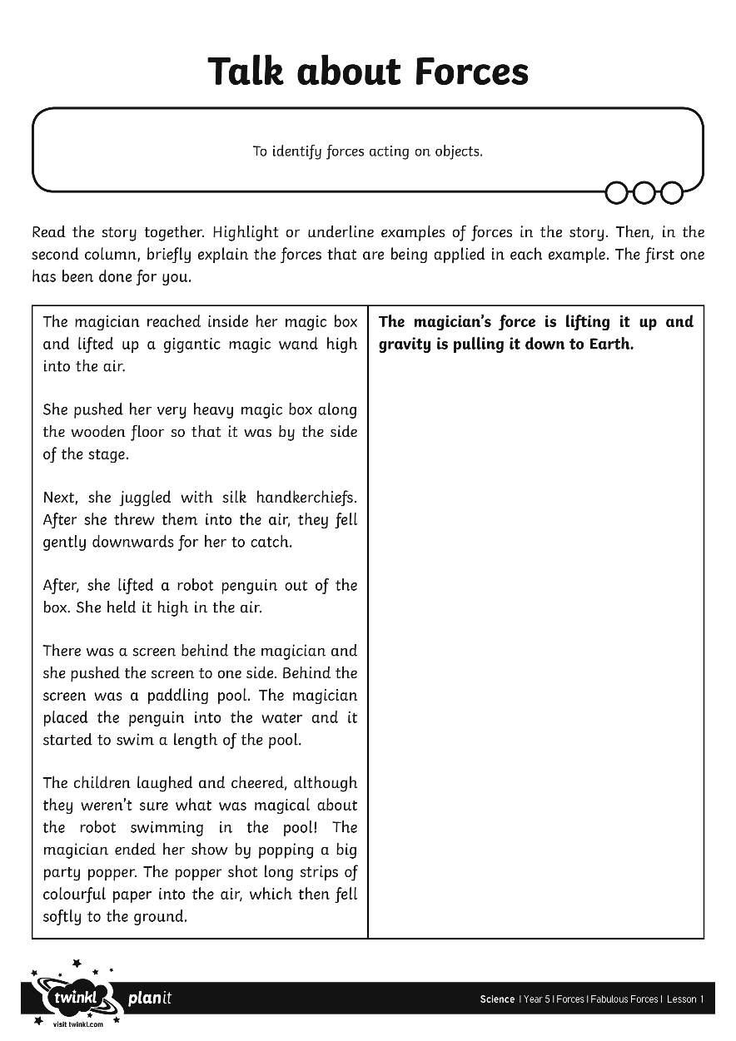

Talk about Forces
You need the print out of this sheet.
In the second column, briefly explain the forces that are being applied in each example.
When you have done this there is an answer sheet to check.
With your partner, read the story on the Talk about Forces Activity Sheet. Highlight or underline examples of forces in the story.

Slide 20
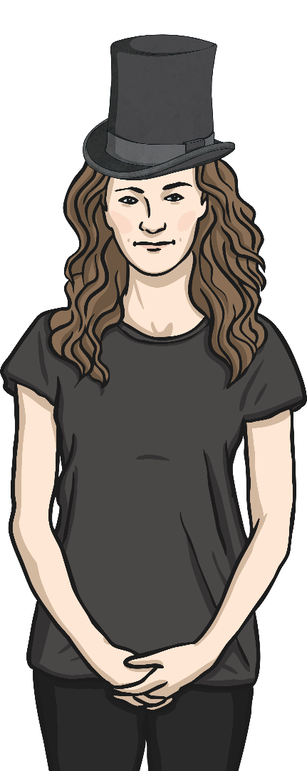

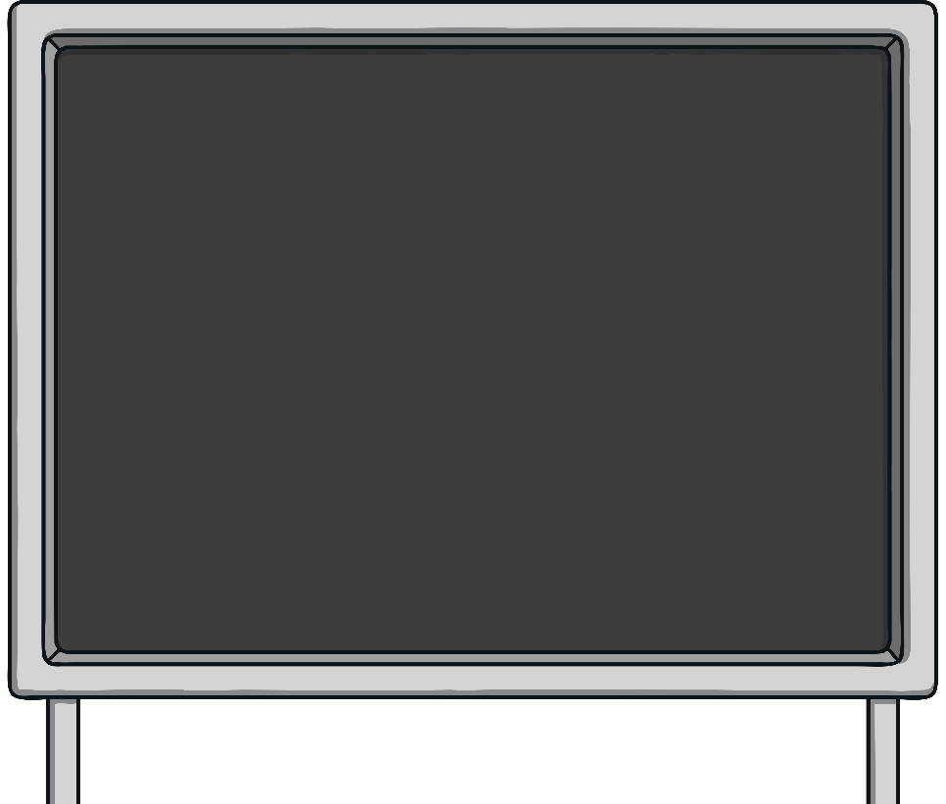
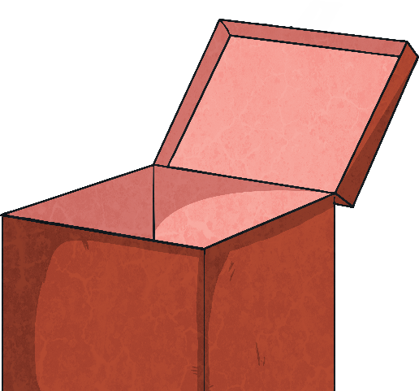
Talk about Forces
Can you explain how some of the forces that you found were acting on the objects?

Slide 21
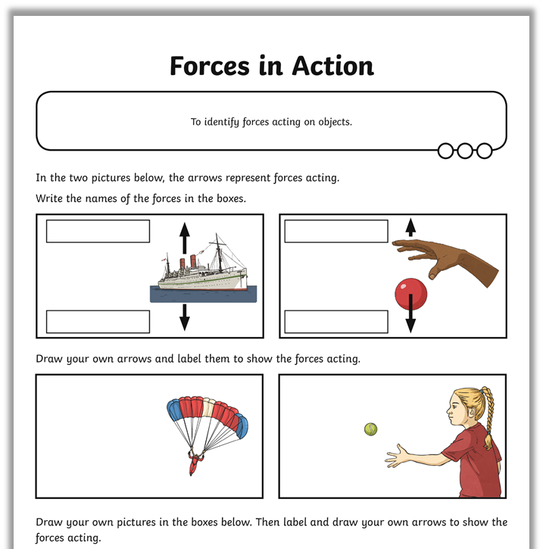
Forces in Action
Complete the Forces in Action Activity Sheet. For each picture, name the forces acting on the objects and draw an arrow for each force to show the direction it is acting in. Then, draw your own examples of forces acting on objects, drawing arrows and labelling the forces.
If you can, talk about this with somebody else.

Slide 22
Aim
To identify forces acting on objects.
Success Criteria
I can identify forces as pushes and pulls.
I can identify and explain the different forces acting on objects.

