Slide 1

Art
Year 3: Landscapes
LO: To further explore surrealism
SO: To create a surreal foreground for a landscape, using perspective
Notes:
Progression
Previous Lesson – Surrealism
Next Lesson – End of Unit
KO – Knowledge Organiser
SO – Subject Organiser

Slide 2

Recall
Who started the surrealist movement?
2. In which decade did surrealism begin?
3. Approximately what year did surrealism end?
Sir Septimus Surreal b) Salvador Dali
c) Andre Breton
1850s c) 1950s
1920s d) 1970s
1966
It has not ended
1988
1924
Notes:
Recall Questions from a Previous unit: Colour
Answers:
Andre Breton
1920s
1966

Slide 3
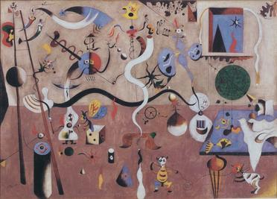

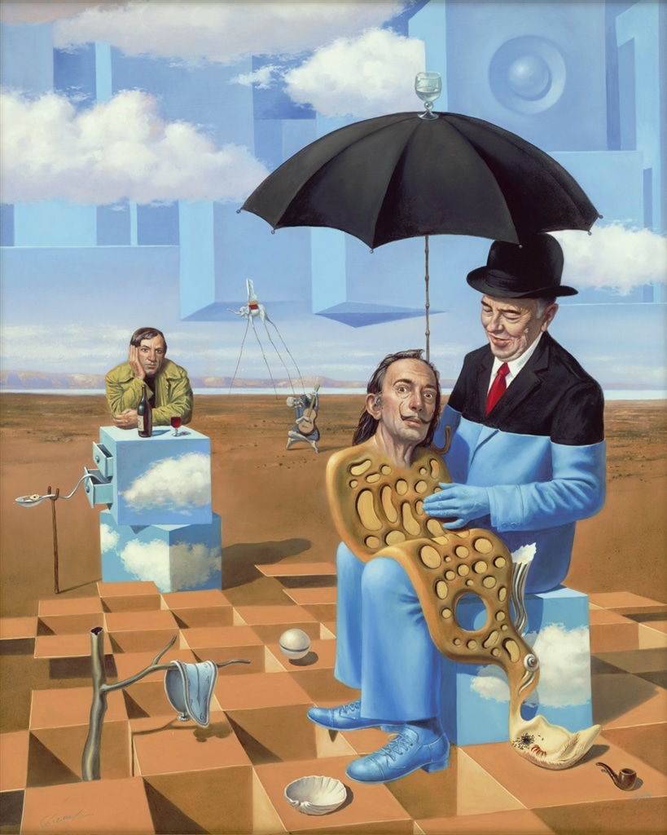
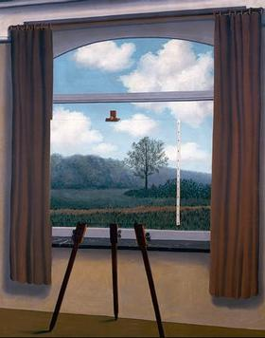
Model
Model
SURREALISM
Joan Miró: Carnival of Harlequin (1924-25)
“Lullaby of Uncle Magritte” (2016), Michael Cheval
Rene Magritte: The Human Condition (1933)
Notes:
What is a Surrealist landscape?
Surrealist landscapes tapped into a different source for imagery: the subconscious mind. The landscapes shown here reflect the uncanny, sometimes elusive imagery of dreams, myth, and fantasy.
What are the 4 major works of Surrealism art?
Famous Surrealist Artworks
Salvador Dalí's The Persistence of Memory (1931)
Rene Magritte's The Treachery of Images (1928)
Joan Miró's The Hunter (Catalan Landscape) (1924)
Frida Kahlo's The Wounded Deer (1946)
Meret Oppenheim's Object (1936)
Man Ray's l'Heure de l'Observatoire: les Amoureux (1932-1934)
Summary of Surrealism
The Surrealists sought to channel the unconscious as a means to unlock the power of the imagination. Disdaining rationalism and literary realism, and powerfully influenced by psychoanalysis, the Surrealists believed the rational mind repressed the power of the imagination, weighing it down with taboos. Influenced also by Karl Marx, they hoped that the psyche had the power to reveal the contradictions in the everyday world and spur on revolution. Their emphasis on the power of personal imagination puts them in the tradition of Romanticism, but unlike their forebears, they believed that revelations could be found on the street and in everyday life. The Surrealist impulse to tap the unconscious mind, and their interests in myth and primitivism, went on to shape many later movements, and the style remains influential to this today.
Carnival of Harlequin (1924-25)
Artist: Joan Miró
Miró created elaborate, fantastical spaces in his paintings that are an excellent example of Surrealism in their reliance on dream-like imagery and their use of biomorphism. Biomorphic shapes are those that resemble organic beings but that are hard to identify as any specific thing; the shapes seem to self-generate, morph, and dance on the canvas. While there is the suggestion of a believable three-dimensional space in Carnaval d'Arlequin, the playful shapes are arranged with an all-over quality that is common to many of Miró's works during his Surrealist period, and that would eventually lead him to further abstraction. Miró was especially known for his use of automatic writing techniques in the creation of his works, particularly doodling or automatic drawing, which is how he began many of his canvases. He is best known for his works such as this that depict chaotic yet lighthearted interior scenes, taking his influence from Dutch 17th-century interiors.
Oil on canvas - Albright-Knox Art Gallery, Buffalo, New York
The Human Condition (1933)
Artist: René Magritte
The iconic and enigmatic René Magritte's works tend to be intellectual, often dealing with visual puns and the relation between the representation of something and the thing itself. In The Human Condition a canvas sits on an easel before a curtained window and reproduces exactly the scene outside the window that would be behind the canvas, thus the image on the easel in a sense becomes the scene, not just a reproduction of the landscape. There is in effect no difference between the two as both are fabrications of the artist. The hyperrealist painting style often used by Surrealists makes the odd setup seem dreamlike.
Oil on canvas - Los Angeles County Museum of Art

Slide 4
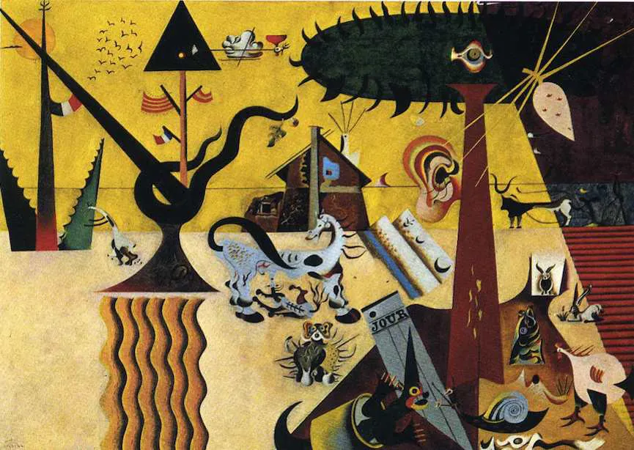
Model
The Tilled Field - Joan Miro
Notes:
Surreal Art is much broader term than the cultural and artistic movement that began in 1920s in artist circles in Paris. Developed from Dada and Avant-garde, with the roots in theory of psychoanalysis, Surrealism soon spread from literature and visual arts to music, photography and film to culture practices, as well as to philosophy, politic work and social theories worldwide. The main topic explored by surrealist artists and writers was the dialogue between dreams and reality, trying to depict affluence of human mind with the emphasis on its subconscious images and surreal landscapes. Here, we will present the collection of 10 surrealist paintings in chronological order to show the uprising of the movement and the most prominent surrealists - Salvador Dalí, André Breton, Yves Tanguy, René Magritte, Joan Miró, Max Ernst and Leonora Carrington.
The Tilled Field is the first of the Joan Miró’s surrealist paintings, after his period of Fauvism. As one of the most important surrealist painters, Miro's vision and vivid colorful imagination unite Catalan landscapes with its history and at the same time reflects the current political situation in Spain during 1920s. The mind of a spectator is overwhelmed with a strong symbolic language that subversively represents a continuity of free spirit ideals of present and past in order to confront the strong dictatorship of Spanish government that neglects the Catalan long lasting autonomous thought and local complexity and surreal landscape.

Slide 5
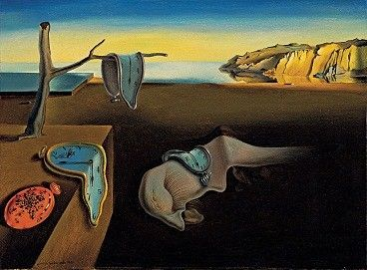
Model
Model
The Persistence of Memory (1931)
Notes:
1931
The Persistence of Memory
This iconic and much-reproduced painting depicts the fluidity of time as a series of melting watches, their forms described by Dalí as inspired by a surrealist perception of Camembert cheese melting in the sun. The distinction between hard and soft objects highlights Dalí's desire to flip reality lending to his subjects characteristics opposite their usually inherent properties, an un-reality often found in our dreamscapes. They are surrounded by a swarm of ants hungry for the organic processes of putrefaction and decay with which Dalí held unshakable fascination. Because the melting flesh at the painting's center resembles Dalí, we might see this piece as a reflection on the artist's immortality amongst the rocky cliffs of his Catalonian home.
Oil on canvas - The Museum of Modern Art, New York

Slide 6
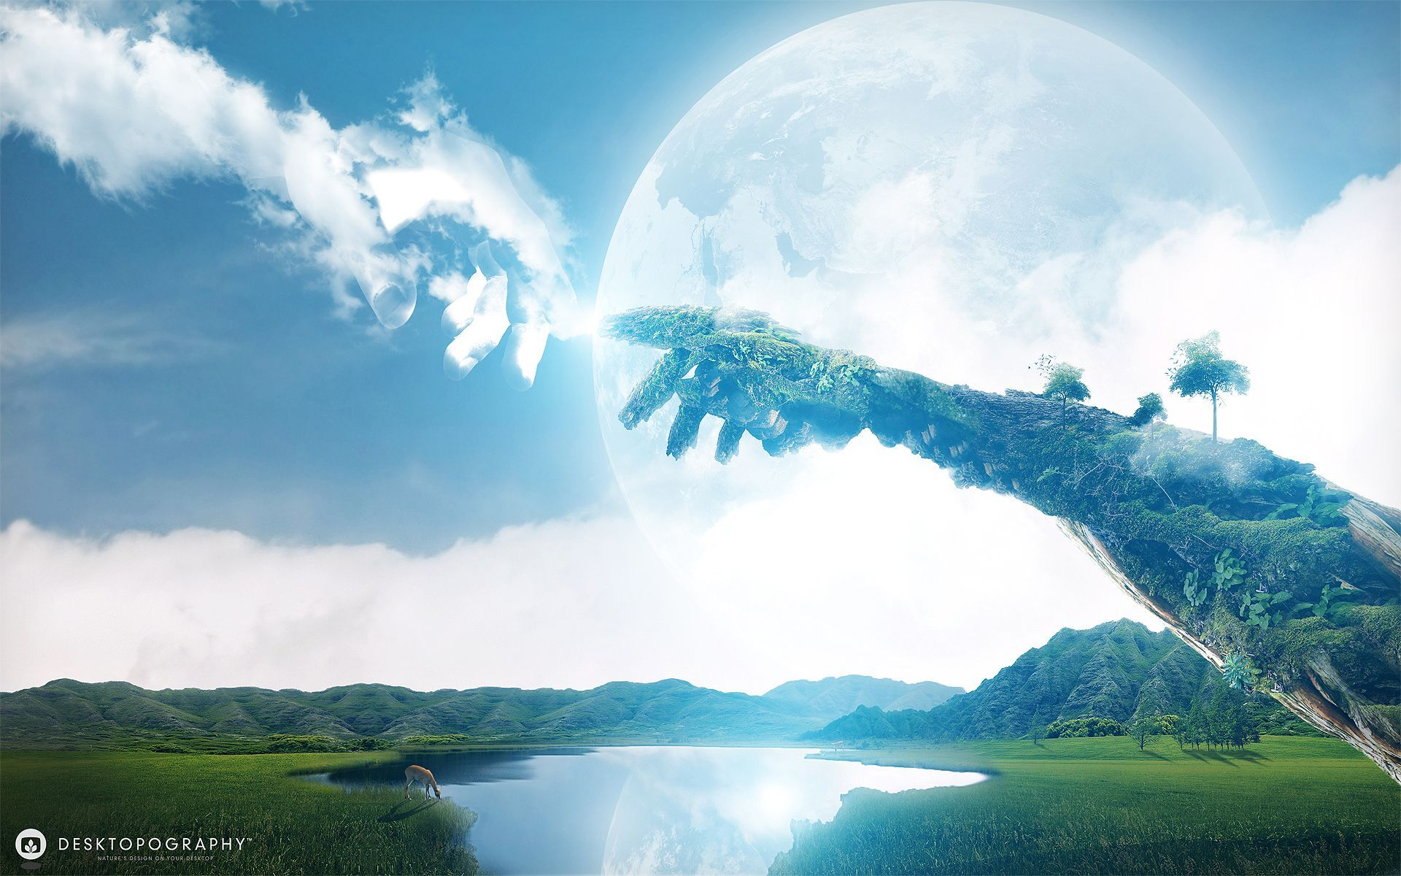
Model
Notes:
Teacher to DESCRIBE IT, Use the questions to inform your answer.
1. How would you describe this painting to a person who could not see it?
2. What kinds of things do you see in this painting?
3. What words would you use to describe this painting?
4. How would you describe the lines in this picture? The shapes? The colors?
RELATE IT
5. What does this painting remind you of?
6. What things do you recognize in this painting? What things seem new to you?
7. How is this picture different from real life?
8. What interests you most about this work of art?
ANALYZE IT
9. What do you think is the most important part of this picture?
10. What questions would you ask the artist about this work if she/he were here?
INTERPRET IT
11. What title would you give to this painting? What made you decide on that title?
12. What do you think is going on in this picture? What is this painting about?
13. Why do you think the artist made this painting?
EVALUATE IT
14. What do you think is good about this painting? What is not so good?
15. Do you think the person who painting this did a good or bad job? What makes you think so?
16. What do you think other people say about this work? 17. What grade would you give the artist for this work? How did you arrive at that grade?
18. If money were no object, would you buy this painting?

Slide 7
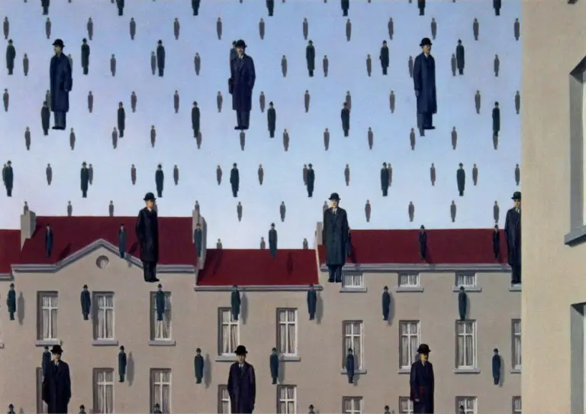
Model
Model
René Magritte, Golconda, 1953
Notes:
1. How would you describe this painting to a person who could not see it?
2. What kinds of things do you see in this painting?
3. What words would you use to describe this painting?
4. How would you describe the lines in this picture? The shapes? The colors?
RELATE IT
5. What does this painting remind you of?
6. What things do you recognize in this painting? What things seem new to you?
7. How is this picture different from real life?
8. What interests you most about this work of art?
ANALYZE IT
9. What do you think is the most important part of this picture?
10. What questions would you ask the artist about this work if she/he were here?
INTERPRET IT
11. What title would you give to this painting? What made you decide on that title?
12. What do you think is going on in this picture? What is this painting about?
13. Why do you think the artist made this painting?
EVALUATE IT
14. What do you think is good about this painting? What is not so good?
15. Do you think the person who painting this did a good or bad job? What makes you think so?
16. What do you think other people say about this work? 17. What grade would you give the artist for this work? How did you arrive at that grade?
18. If money were no object, would you buy this painting?

Slide 8
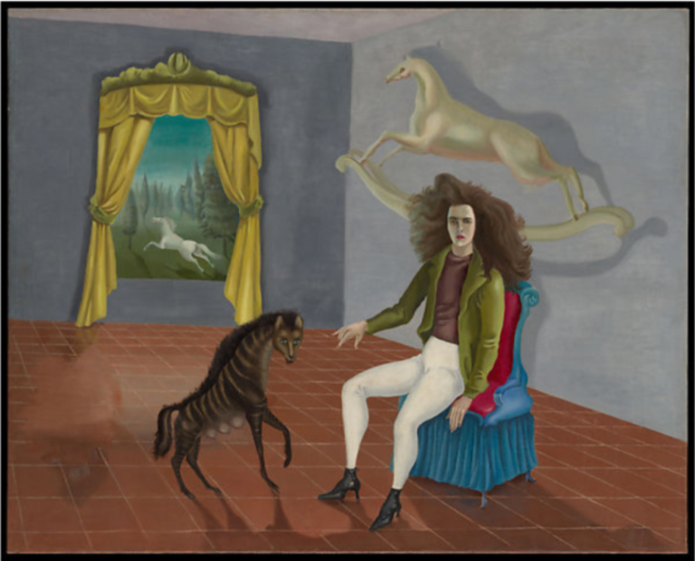
Model
Leonora Carrington, Self-Portrait, 1937-1938
Notes:
One of the many overlooked female Surrealist artists, the American painter Leonora Carrington was a bold artist. She managed to establish herself as a key figure of Surrealism despite the discrimination of her male peers. Many of the male artists of Surrealism were rather misogynistic. They would solely acknowledge women as a mere sexual desire and object. Thankfully women such as Leonora Carrington depicted the deeper female experience, particularly in male-dominated societies and environments. In this self-portrait, she explores her femininity by creating a mimesis between her and a hyena, relating herself to the animal’s rebellious nature.

Slide 9

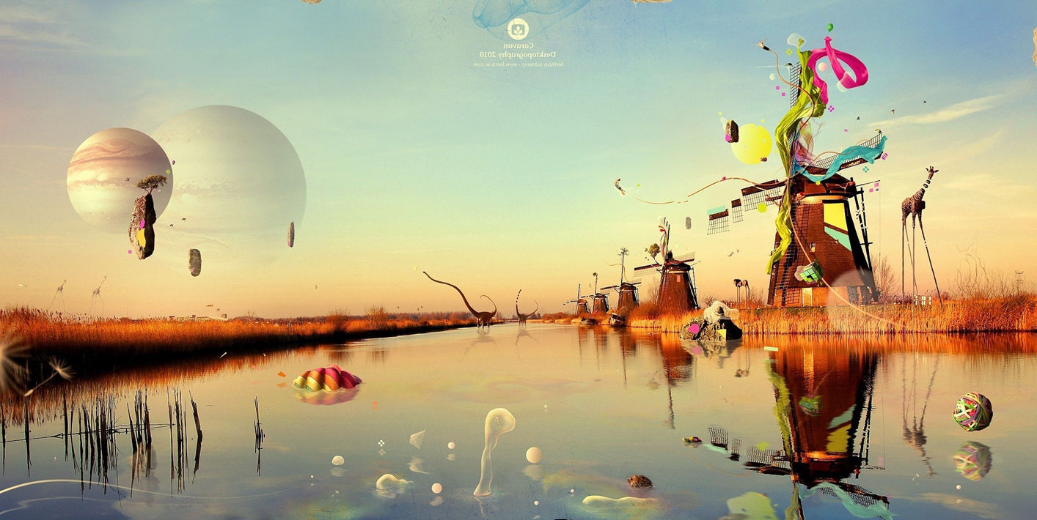
Question
DESCRIBE IT
Notes:
Questions
DESCRIBE IT
1. How would you describe this painting to a person who could not see it?
2. What kinds of things do you see in this painting?
3. What words would you use to describe this painting?
4. How would you describe the lines in this picture? The shapes? The colors?
RELATE IT
5. What does this painting remind you of?
6. What things do you recognize in this painting? What things seem new to you?
7. How is this picture different from real life?
8. What interests you most about this work of art?
ANALYZE IT
9. What do you think is the most important part of this picture?
10. What questions would you ask the artist about this work if she/he were here?
INTERPRET IT
11. What title would you give to this painting? What made you decide on that title?
12. What do you think is going on in this picture? What is this painting about?
13. Why do you think the artist made this painting?
EVALUATE IT
14. What do you think is good about this painting? What is not so good?
15. Do you think the person who painting this did a good or bad job? What makes you think so?
16. What do you think other people say about this work? 17. What grade would you give the artist for this work? How did you arrive at that grade?
18. If money were no object, would you buy this painting?

Slide 10

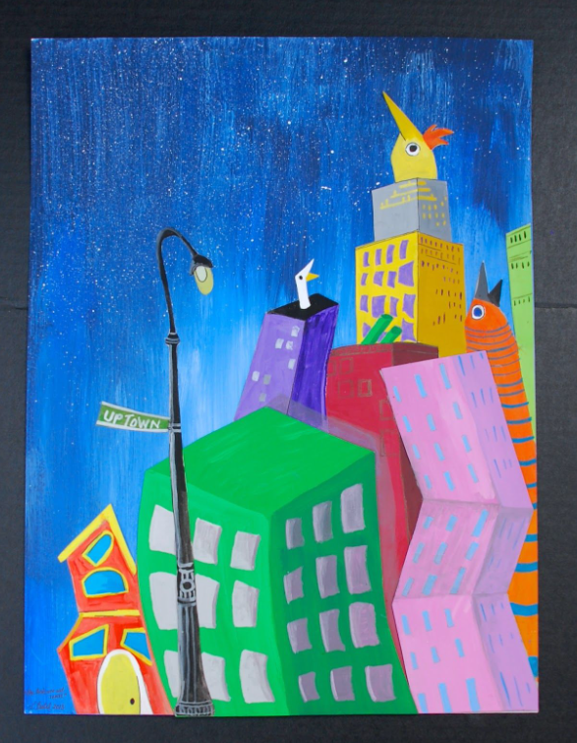


Guided Practice
Notes:
Draw a building in style of the surrealist movement.

Slide 11

Assessment point
Who started the surrealist movement?
2. Salvador Dali made paintings and sculptures about?
3. Approximately what year did surrealism end?
Sir Septimus Surreal b) Salvador Dali
c) Andre Breton
Dreams c) Family
Italy d) Friends
1966
It has not ended
1988
1924
Notes:
Answers:
Andre Breton
Dreams
1966

Slide 12

Independent Practice
Notes:
To create a surreal background for a landscape, using perspective
To add the buildings to their background from last week, using perspective and idea of surrealism.

Slide 13

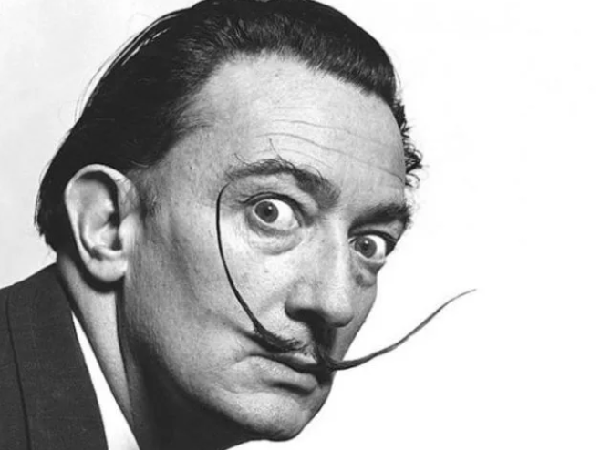
Quiz
Constable painted a lot of his landscapes where?
What is a landscape?
What is a one-point perspective drawing?
What does VP stand for?
What is Surrealism?
Why was it called surrealism?
What is the main idea of surrealism?
Who is this famous surrealist artist?
Why were the surrealists interested in the irrational?
Why do you think the Surrealists though it was important opt reach a level of perception that went beyond reality?
Notes:
Quiz Answers
Constable painted a lot of his landscapes where? Outside
What is a landscape? A painting or drawing of a large area of the natural world, for example mountains or fields.
What is a one-point perspective drawing? One point located on the horizon.
What does VP stand for? Vanishing Point
What is surrealism?
Why was it called surrealism? Because the surrealists were interested in ideas and images that were above or beyond real.
What is the main idea of surrealism? To express imaginative dreams and visions from the unconscious mind that are free from rational control.
Who is this famous surrealist artist? Salvador Dali
Why were the surrealists interested in the irrational?
Why do you think the Surrealists though it was important opt reach a level of perception that went beyond reality?

