Slide 1


Slide 3

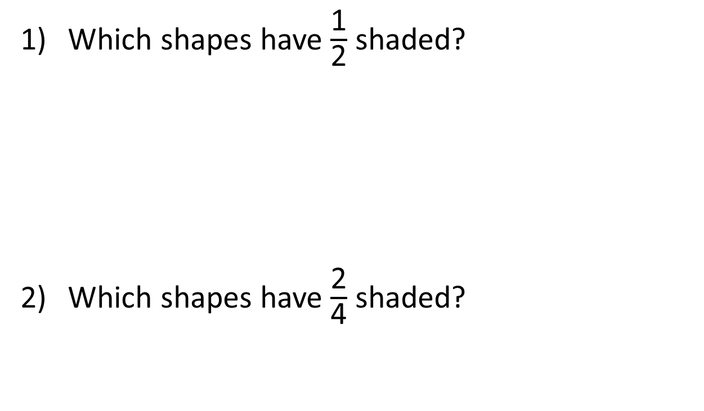
Which shapes have $\frac{\text{1}}{\text{2}}$ shaded?
Which shapes have $\frac{\text{2}}{\text{4}}$ shaded?

Slide 4
Which shapes have $\frac{\text{1}}{\text{2}}$ shaded?
Which shapes have $\frac{\text{2}}{\text{4}}$ shaded?

Slide 6
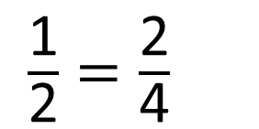
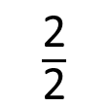
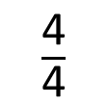
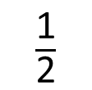
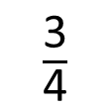
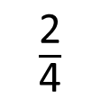
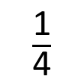
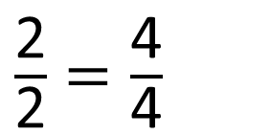
0
$\frac{\text{1}}{\text{2}}$
1
$\frac{\text{2}}{\text{2}}$
$\frac{\text{1}}{\text{4}}$
$\frac{\text{2}}{\text{4}}$
$\frac{\text{3}}{\text{4}}$
0
1
$\frac{\text{4}}{\text{4}}$
$\frac{\text{1}}{\text{2}}=\frac{\text{2}}{\text{4}}$
$\frac{\text{2}}{\text{2}}=\frac{\text{4}}{\text{4}}$

Slide 7

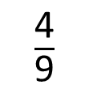
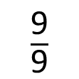
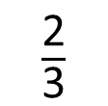
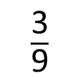
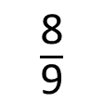
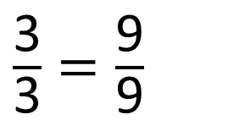
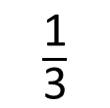
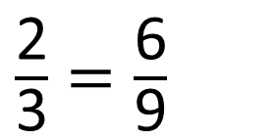
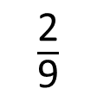
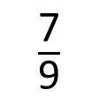
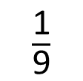
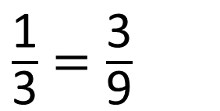
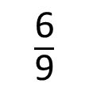
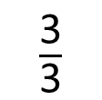
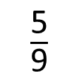
$\frac{\text{1}}{\text{3}}$
$\frac{\text{2}}{\text{3}}$
0
1
$\frac{\text{3}}{\text{3}}$
$\frac{\text{1}}{\text{9}}$
$\frac{\text{2}}{\text{9}}$
$\frac{\text{3}}{\text{9}}$
$\frac{\text{4}}{\text{9}}$
$\frac{\text{5}}{\text{9}}$
$\frac{\text{6}}{\text{9}}$
$\frac{\text{7}}{\text{9}}$
$\frac{\text{8}}{\text{9}}$
0
1
$\frac{\text{9}}{\text{9}}$
What do you notice?
Have a think
$\frac{\text{1}}{\text{3}}=\frac{\text{3}}{\text{9}}$
$\frac{\text{2}}{\text{3}}=\frac{\text{6}}{\text{9}}$
$\frac{\text{3}}{\text{3}}=\frac{\text{9}}{\text{9}}$

Slide 8
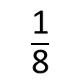
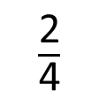
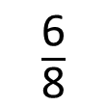
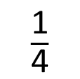
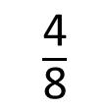
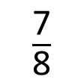
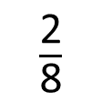
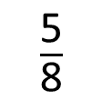
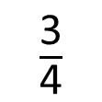
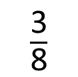
Have a think
0
$\frac{\text{1}}{\text{4}}$
$\frac{\text{2}}{\text{4}}$
$\frac{\text{3}}{\text{4}}$
1
0
$\frac{\text{1}}{\text{8}}$
$\frac{\text{2}}{\text{8}}$
$\frac{\text{3}}{\text{8}}$
$\frac{\text{4}}{\text{8}}$
$\frac{\text{5}}{\text{8}}$
$\frac{\text{6}}{\text{8}}$
$\frac{\text{7}}{\text{8}}$
1
I know ___ is equivalent to ___

Slide 9
Have a go at questions 1-3 on the worksheet.

Slide 10
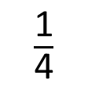
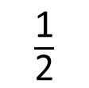
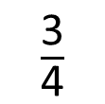
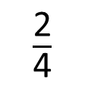
0
$\frac{\text{1}}{\text{4}}$
$\frac{\text{2}}{\text{4}}$
$\frac{\text{3}}{\text{4}}$
1
0
$\frac{\text{1}}{\text{2}}$
1
Have a think
Do these number lines show that $\frac{\text{3}}{\text{4}}$ is equivalent to $\frac{\text{1}}{\text{2}}$ ?

Slide 11
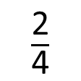
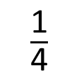
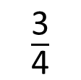
0
$\frac{\text{1}}{\text{4}}$
$\frac{\text{2}}{\text{4}}$
$\frac{\text{3}}{\text{4}}$
1
0
$\frac{\text{1}}{\text{2}}$
1
$\frac{\text{2}}{\text{4}}$ is equivalent to $\frac{\text{1}}{\text{2}}$

Slide 12
Have a go at questions 4-5 on the worksheet.

Slide 13
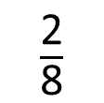
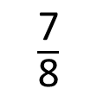
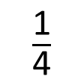
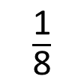
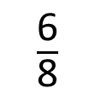

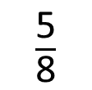
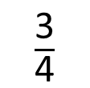
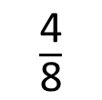
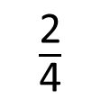

Have a think
$\frac{\text{1}}{\text{8}}$
$\frac{\text{2}}{\text{8}}$
$\frac{\text{3}}{\text{8}}$
$\frac{\text{4}}{\text{8}}$
$\frac{\text{5}}{\text{8}}$
$\frac{\text{6}}{\text{8}}$
$\frac{\text{7}}{\text{8}}$
0
$\frac{\text{1}}{\text{4}}$
$\frac{\text{2}}{\text{4}}$
$\frac{\text{3}}{\text{4}}$
1
Estimate where $\frac{\text{3}}{\text{8}}$ would go on this number line.

Slide 14
Have a go at the rest of the worksheet.

